Slide 1
Quant Model: Random Forest
Random Forest with bagging
Regression Tree: Many trees make up a forest
Bagging: Fit trees with random samples drawn from training data
Random forest: Fit many trees using subsets of features to fit each tree.
Prediction: Average the prediction from each tree to get the final prediction. This called the Ensemble method.
Use RandomForestRegressor from scikit.
See: https://scikit-learn.org/0.16/modules/generated/sklearn.ensemble.RandomForestRegressor.html

Slide 2




Regression Tree
Root Node
X<=x*
X>x*
Node 1
Node 2
X<=x**
X>x**
Z<=Z*
Z>Z*
Terminal Node 1
Terminal Node 2
Terminal Node 3
Terminal Node 4
$${\hat{Y}}_{1}$$
$${\hat{Y}}_{2}$$
$${\hat{Y}}_{3}$$
$${\hat{Y}}_{4}$$
$Target=Y Features=\left[X, Z\right]$ Predicted Values =[${\hat{Y}}_{1}$, ${\hat{Y}}_{2}$, ${\hat{Y}}_{3}$, ${\hat{Y}}_{4}$]

Slide 3
Bagging
Overfitting: Regression trees tend to over fit
Bagging: Fit regression trees with randomly selected sample from the training dataset
Bootstrap: Randomly draw the samples with replacement from the training dataset.
In the RandomForestRegressor algorithm, the size of each “bag” or each random sample, equals the size of original sample
The samples in each bag selected with replacement from the 2/3rd of the observations in the training dataset. The other 1/3rd are out-of-bag (OOB)

Slide 4

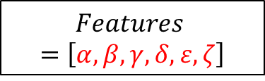
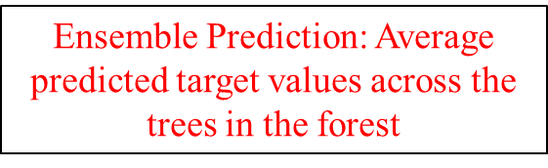
Bagging
Observations
A, B, C, D, E, F
Training Set
A, B, C, D, E, F
$$Features=\left[α, β, γ, δ, ε,ζ\right]$$
Bag 1
A, A, B, E, E,F
Bag 2
B, C, D, D, F, F
$$…$$
Bag N
A, A, C, D, D, F
Tree 1 … N
Tree 1 … N
$$…$$
Tree 1 … N
$\text{Ensemble}$ Prediction: Average predicted target values across the trees in the forest

Slide 5
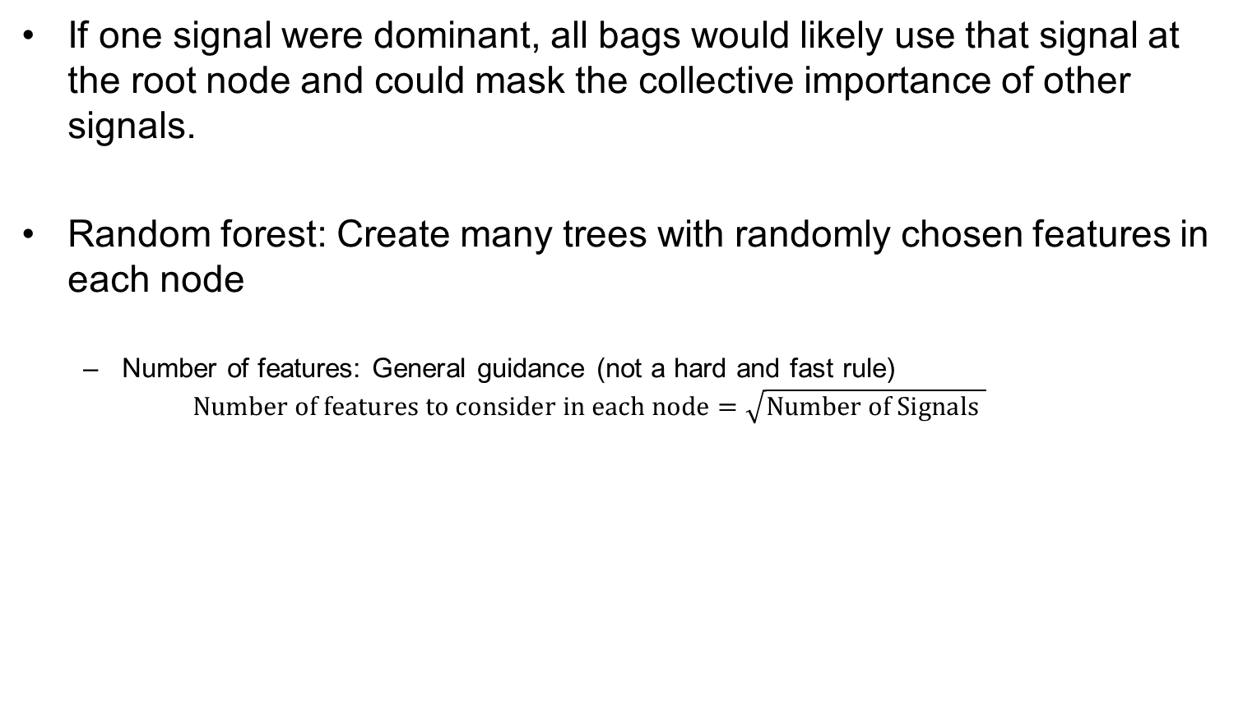
Random Forest
If one signal were dominant, all bags would likely use that signal at the root node and could mask the collective importance of other signals.
Random forest: Create many trees with randomly chosen features in each node
Number of features: General guidance (not a hard and fast rule)
$$Number of features to consider in each node=\sqrt{Number of Signals }$$

Slide 6

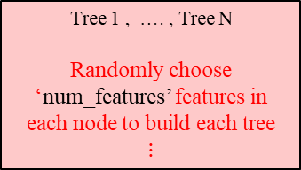
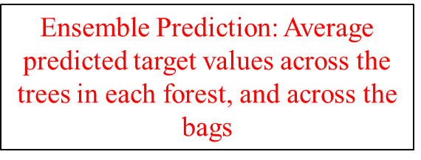

Bagging and Random Forest
Training Set
A, B, C, D, E, F
Bag 1
A, A, B, E, E,F
Bag 2
B, C, D, D, F, F
$$…$$
Bag N
A, A, C, D, F, F
Tree 1 , …. , Tree N
Randomly choose ‘num_features’ features in each node to build each tree
$$⋮$$
Tree 1, …. Tree N
$$⋮$$
Tree 1. …. Tree N
$$⋮$$
$$…$$
N: Number of trees in the forest; ‘n_estimators’
$\text{Ensemble}$ Prediction: Average predicted target values across the trees in each forest, and across the bags

Slide 7
Hyperparameters
Hyperparameters are parameters for the algorithm chosen by the modeler
Random forest Hyperparameters?
RandomForestRegressor(n_estimators=trials, max_features= num_features, max_depth= max_tree_depth).fit(train_X, train_y)
https://scikit-learn.org/0.16/modules/generated/sklearn.ensemble.RandomForestRegressor.html

Slide 8
Random Forest: Back test
Specify hyperparameters
Get out-of-sample predicted returns for each stock, for each month
Decile portfolio returns

